Slide 1
SCC204 Software Design
Design Pattern
(State Pattern)
Zhang Jinyu
zjy@bjtu.edu.cn

Slide 2
Objectives
After studying today’s material, you should be able to:
Understand a way to link requirements to implementation (i.e., a design pattern)
Describe the trade-offs of implementing state machines in object-oriented languages
Describe what is meant by the State pattern
Be able to apply the State pattern to real-world situations

Slide 3
Statecharts
Statecharts, a graphical formalism developed by David Harel for modelling reactive systems, allow you to trace the behaviour of your system, given specific inputs
Statecharts extend the finite state machine formalism to support description of the transitions within a state in terms of nested states
响应
状态图扩展了有限状态机的形式，以支持用嵌套状态来描述状态内的转换

Slide 4
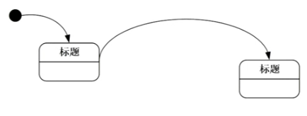
Statechart Objects
必须画起始图
state_label
State (label)
transition_label
Transition (label)
transition_label
Initial transition (label)
parallel_state
And-line
C
H
…
Connectors

Slide 5
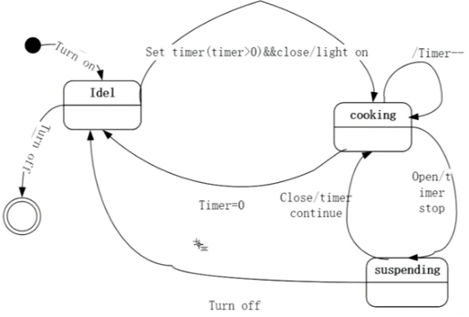
State Transition
[]:表示里面可有可无
Event[condition]/action
A
B

Slide 6
State Hierarchy
state1
state2, state3, and state4 are XOR-children of state1
if state1 is the current state, only one of the XOR-children is the current state
state2
state4
state3
state1
state2 state3
state2 and state3 are parallel children of state1.
state4 and state5 are XOR-children of state2.
When state1 is the current state, both state2 and state3 are the current states.
state4
state6
state5
state7

Slide 7
Guard/Action Specification(GAS)
GAS is used in many parts of the Statechart specifications
GAS action is executed if the guard is satisfied.
Guard = event_spec[condition_spec]

Slide 8
Event Specification
Expression in the form of the parentheses, &(and)’s and |(or)’s of events
Satisfied when the given combination of the events is occurred at that moment
Events are instantaneous, that is, it should be sensed when occurred.

Slide 9
Condition Specification
Expression in the form of the &(and)’s and |(or)’s of conditions

Slide 10
Action Specification
Generating events
generate an event in an action
ev1[condA]/ev2
Assignments
sum := mathscore + englishscore
Multiple actions are separated by comma(,)s.
ev1[condA]/ev2, ev3, a:=3

Slide 11
Transition Texts
/ev
state1
state1
state1
state1
ev
[cond]
ev[cond]
state2
state2
state2
state2
All transitions except default transitions should have a guard.
Default transitions does not have a guard and an action is optional.
事件

Slide 12
Condition Connector
state1
ev[cond]
[val>50]
state2
C
[val=50]
state3
[val<50]
state4
Exactly one outgoing flow should be triggered when a condition connector is entered.

Slide 13
Syntactic Rules
States should not be overlapped.
When a state has XOR children, there should be one child which is the destination of a default transition.
A transition should start and end at a state except the default transition.
(x)

Slide 14
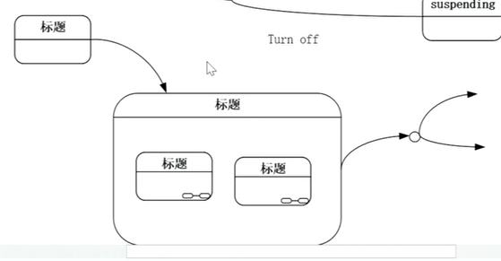
Syntactic Rules (cont’d)
A transition cannot go through a state which is decomposed into parallel children.
Transition cannot go through and-line.
(x)
(x)

Slide 15
Operational Semantics
A Statechart is executed step by step.
Every change (events, data, conditions, current states) in a step makes effects on the next step.
Lifetime of an event is a single step.
Events are broadcasted.

Slide 16
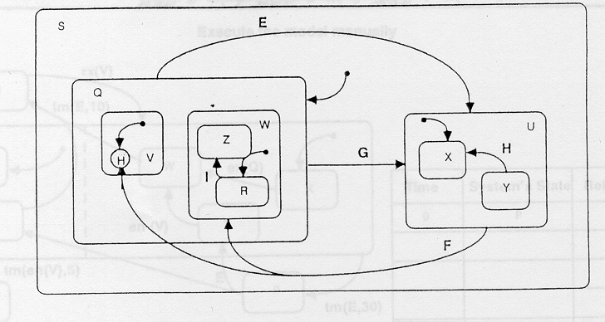
A Short Question…
Find 7 Errors
?
6
S没有起点
Q没有起点
E,G冲突，只能有一条
1
H:迁移线不能终结于连接器，必须终结于状态
7
2
3
5
无法到达Y状态
不能穿越状态
4
不能分支，要加C

Slide 17
An Example: My_system
My_system
On
Idle
pushB
Busy
unpushB
Read_data
Processing
c_ready
turn_on
R_ready
Calculating
/read
read
read_end/
c_ready
c_done
Initialising
turn_off
R_busy
Saving
c_saved/read
Off

Slide 18
Exercise: Automated Passenger Train Service
An Automated Passenger Train Service allows passengers to buy tickets at station machines for a particular journey
Driverless trains receive information about passenger requests
Trains autonomously bid to transport the passenger
A central broker chooses the “best” bid and directs the chosen train to transport the passenger

Slide 19
Task
Draw a statechart for an autonomous train (as described in the previous slide) that captures the bidding and transporting behaviour of the train
(a) without using any hierarchy
(b) using hierarchy

Slide 20
Candidate States
INACTIVE
WAITING
TRANS-
PORTING
BIDDING

Slide 21
Possible Solution: (a)
activate/
INACTIVE
WAITING
completed/return
orderAvailable/
bid(x)
TRANS-
PORTING
denied/
BIDDING
accepted/transport

Slide 22
Possible Solution: (b)
activate/
SUPER STATE
activate/
INACTIVE
WAITING
completed/return
orderAvailable/
bid(x)
TRANS-
PORTING
denied/
BIDDING
deactivate/wait
deactivate/
accepted/transport

Slide 23
How to implement this in an OO language?
switch statements
the State Pattern
state diagram structure becomes class hierarchy
the State Table Pattern
state diagram structure becomes runtime object structure

Slide 24
With switch statements
public class TrainState {
public enum StateID {INACTIVE, WAITING, TRANSPORTING, BIDDING}
public enum EventID {ACTIVATE, COMPLETED, ACCEPTED, DENIED, ORDERAVAILABLE}
private StateID state;
private EventID event;
TrainState() {
state = INACTIVE;
// initialize
}
while (true) {
if (q.nonempty()) {
event = q.pop();
switch (state) {
case INACTIVE:
switch (event) {
case ACTIVATE:
state = StateID.WAITING;
// do something
…
}
…
}
...
}
}
}
variable stores current state
variable stores current event (popped off an event queue)
one switch statement for each state and for each event
doesn’t handle hierarchy well
serious maintenance problems
switch问题：不同处理层次结构，维护

Slide 25
Make events method calls…
public class TrainState {
public enum StateID {INACTIVE, WAITING, TRANSPORTING, BIDDING}
private StateID state;
TrainState() {
state = INACTIVE;
// initialize
}
public void activate() {
if (state == StateID.INACTIVE) {
// do something
state = StateID.WAITING;
} else throw new InvalidEventException();
}
….
}
one method call per event
still enumeration for states
doesn’t handle hierarchy well

Slide 26
one object for each state…
TrainState
State
currentState
activate()
completed()
accepted()
denied()
orderAvailable()
activate()
completed()
accepted()
denied()
orderAvailable()
currentState.activate();
currentState.completed();
currentState.accepted();
currentState.denied();
currentState.orderAvailable();
InactiveState
…
WaitingState
activate()
completed()
accepted()
denied()
orderAvailable()
activate()
completed()
accepted()
denied()
orderAvailable()

Slide 27
State pattern implementation (1)
abstract class State {
static TrainState train;
static State initialState;
static final State inactive = new InactiveState(train);
static final State waiting = new WaitingState(train);
…
protected State(TrainState train) {
if (initialState == null) initialState = this;
this.train = train;
}
abstract void activate();
abstract void completed();
abstract void accepted();
abstract void denied();
abstract void orderAvailable();
}

Slide 28
State pattern implementation (2)
public class TrainState {
private State currentState;
//Create the object and initialize its state
public TrainState() {
this.currentState = State.inactive;
}
// Set the new state
public void setState(State newState) {
this.currentState = newState;
}
// take the next event
….
// delegate event to the currentState
public void activate() {
currentState.activate();
}
…
}

Slide 29
State pattern implementation (3)
class InactiveState extends State {
void activate() {
train.setState(State.waiting);
}
}

Slide 30
State Pattern
Intent
Allow an object to alter its behaviour when its internal state changes. The object will appear to change its class.
Motivation
Often, an object is expected to behave differently depending on which state it is currently in
Example:
In a lift, pressing a floor button has a different effect depending on whether the door of the lift is open or closed
Applicability
Use this pattern when:
An object’s behaviour depends on its state, and it must change its behaviour at runtime depending on that state
Operations have large, multi-part conditional statements that depend on the object’s state

Slide 31
Participants
Context (TrainState):
Maintains an instance of a ConcreteState subclass that defines the current state
State (State):
Defines an interface for encapsulating the behaviour associated with a particular state of the Context
ConcreteState (InactiveState, etc.)
Each subclass implements a behaviour associated with a state of the Context
Collaborations:
Context delegates state-specific requests to the ConcreteState object
A context may pass itself as an argument to the State object handling the request, letting the State object access the Context if necessary

Slide 32
State Pattern structure
Context
State
state
request()
handle()
state.handle();
ConcreteStateA
ConcreteStateB
handle()
handle()

Slide 33
Consequences
handles hierarchy very naturally
create a subclass for each substate
override superstate actions if necessary
Just a structuring mechanism
implementation strategy of different states left open
could use an enumerated variable for events, for instance
Who defines the state transitions?
State can return the next state but then ConcreteStates become dependent
Context can define them if they are fixed
Singleton pattern to define states
The State class can be used to implement default versions of events
for instance, “do nothing” for events that do not apply to a particular ConcreteState

Slide 34
Hierarchy in State Pattern
SUPER STATE
activate/
WAITING
SuperState
deactivate()
orderAvailable/
bid(x)
denied/
BIDDING
WaitingState
BiddingState
deactivate()
deactivate()
deactivate/
No need for repetition of deactivate logic!

Slide 35
State Table Pattern
考试题：状态图和状态表适应什么情况
State Diagram can have many objects for large state diagrams
can be a problem in real-time, embedded systems with limited amount of memory
State Table Pattern is based on a m x n state table
m = number of states
n = number of transitions
each cell contains a pointer to a Transition object, which handles the event with a handle() operation
handle() operation returns the next state
hierarchy is dealt with by “flattening” the state diagram
can be very difficult to maintain

Slide 36
Implementing UML State Diagrams
In reality, implementing UML State Diagrams is hard!
many syntactic constructs, some of which are quite complex
History states
Orthogonal regions
complex execution semantics
PhDs have been written on this topic
Implementing state diagrams is a common task, especially for real-time and/or embedded systems
many tools on the market will do this for you
e.g., Rhapsody
but, the generated implementations are difficult to read and/or maintain
不关联

Slide 37
Learning outcomes
Can you:
Describe the State Pattern
Describe the State Table Pattern
Explain when to use each
Apply these patterns in practice to solve design problems?
基于事件的编程，一个事件激发状态变化
层次，大的模式
扁平，少的模式
考试题

Slide 38
Question？

